Slide 1
P-571- Apple stock Forecast
Group - 3

Slide 2
Abstract:
The study analyzed Apple's stock performance using seven years of market data from 2012 to 2019, examining daily price movements to identify patterns and trends that could predict future stock behavior

Slide 3
Business Objective:
This project aimed to forecast Apple's stock price for the next 30 days to help investors and business leaders make better financial decisions.
The analysis focused on understanding how Apple's stock responds to market changes and external events, providing insights into both short-term fluctuations and longer-term investment trends.

Slide 4
Data Overview:
Data we're using for the Apple stock prediction:
Date: When the trading happened.
Open: Price at the start of the day.
High: Highest price during the day.
Low: Lowest price during the day.
Close: Price at the end of the day
Adj Close: Closing price adjusted for things like stock splits.
Volume: How many shares were traded.
These are the key pieces of information that help us understand the stock's performance each day.

Slide 5
Key Insights:
Looking at the graph of Apple's stock closing prices from 2012 to 2019, we can see a strong positive trend. This means that over this period, the stock price generally increased, which is a good sign for investors.
There are ups and downs along the way, as is normal with any stock, but the overall movement is upwards. This upward trend suggests that the company performed well and investor confidence grew during these years.

Slide 6
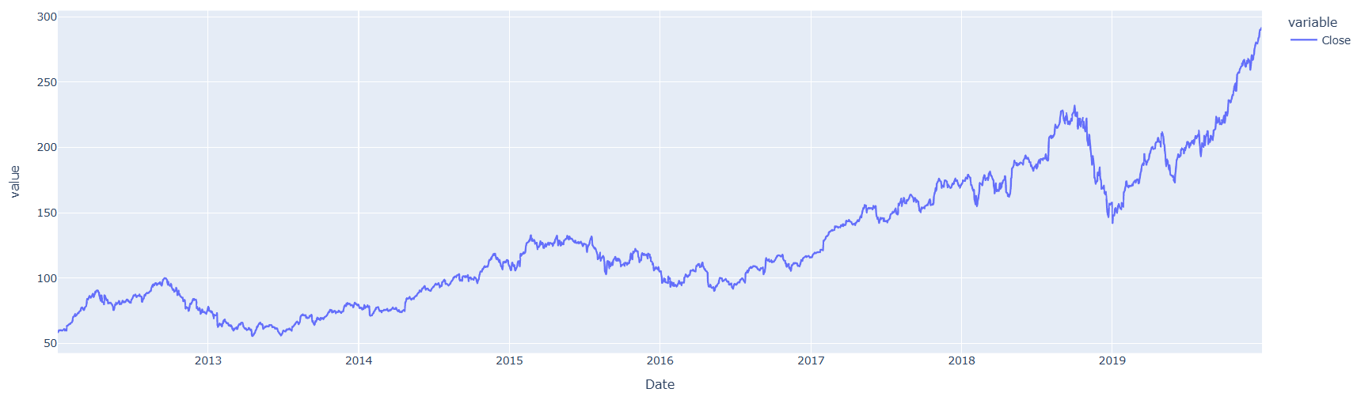

Slide 7
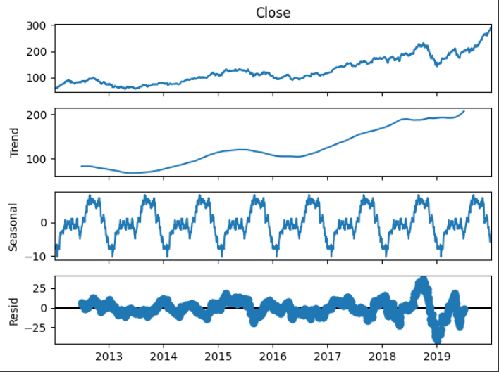
The Seasonal plot highlights patterns repeat around the same time each year. Maybe there's a bump in the stock price after a new iPhone launch.
Dip during January when Samsung launch their new
smartphone launch.

Slide 8
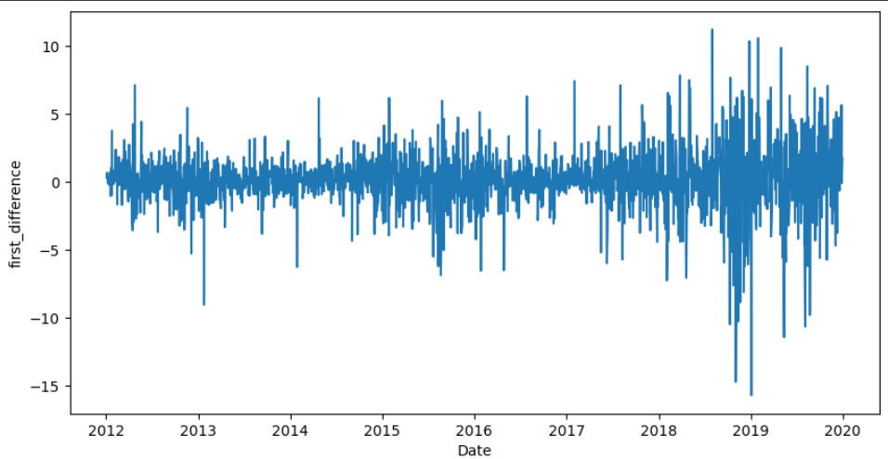
Daily Returns:

Slide 9
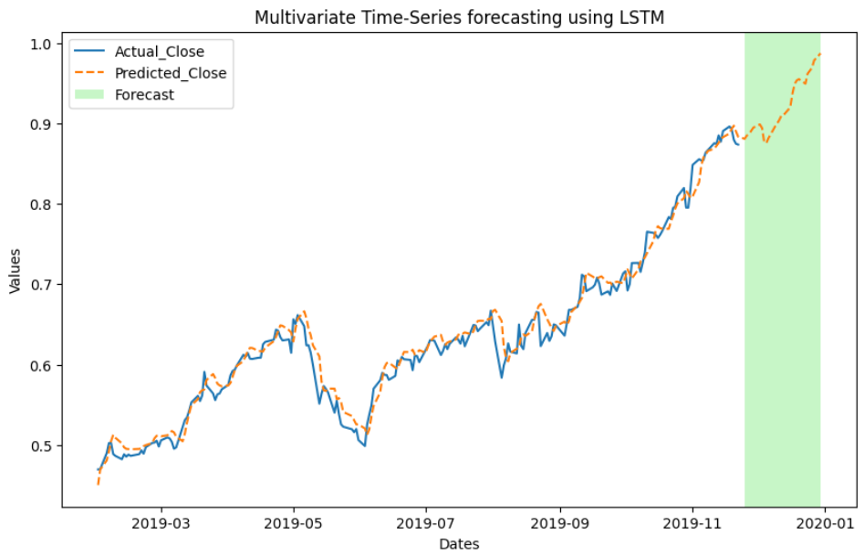
Forecast:

Slide 10
Value to Business:
Strategic Investment Decisions: Apple stock price forecasting enables investors and portfolio managers to make informed timing decisions regarding when to buy, hold, or sell positions.
Enhanced Risk Management: The 30-day forecast provides advance warning of potential market volatility, allowing investors to adjust portfolio allocations or implement protective strategies before significant price movements occur.

Slide 11
Challenges :
Market Volatility and Unpredictability: Stock markets experience sudden price swings due to economic news, investor sentiment, and global events, making it difficult to create reliable forecasts. Apple's stock can fluctuate dramatically based on product launches, earnings reports, or market rumors.
Data Quality and Consistency Issues: Historical stock data contain gaps, or inconsistencies that can affect forecast accuracy. Missing trading days, stock splits, or dividend adjustments can create data challenges that impact model reliability.

Slide 12
Conclusion:
Apple's stock has shown strong growth and our model can capture this trend over the past several years (2012-2019), Apple's stock price has generally been moving upwards.
Based on the historical patterns and the model's performance, the forecast suggests the upward trend is likely to continue in the short term.
However, it's crucial to remember that this is a prediction based on past data. The stock market can be unpredictable, and unexpected events can always influence prices. So, while the model provides a good estimate, it's not a guarantee of future stock performance.

